Slide 1
Registration with Iraqi Journal of pharmaceutical sciences
( Open Journal System OJS )

Slide 2
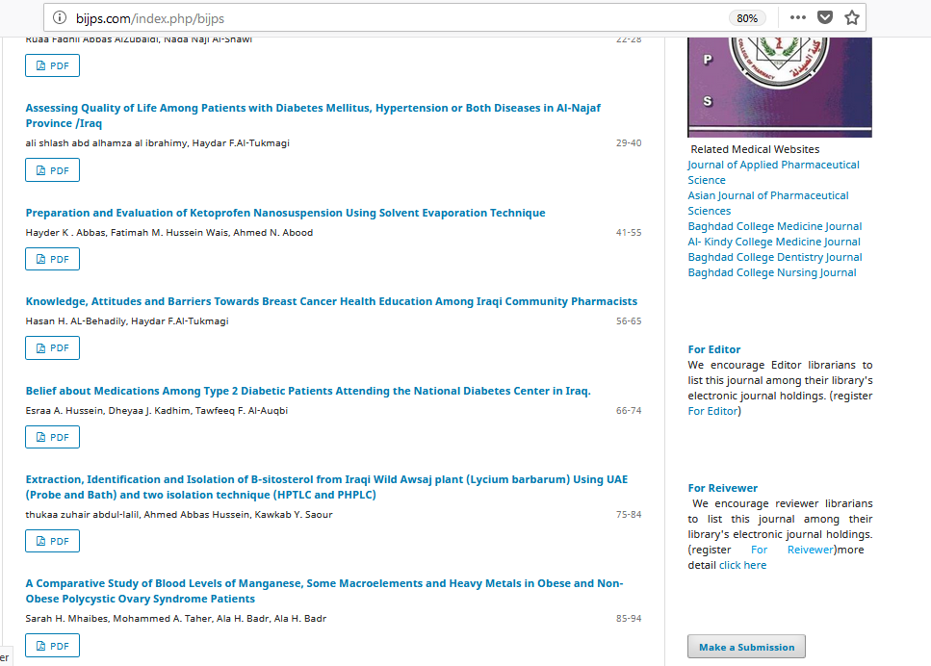
Click here

Slide 4
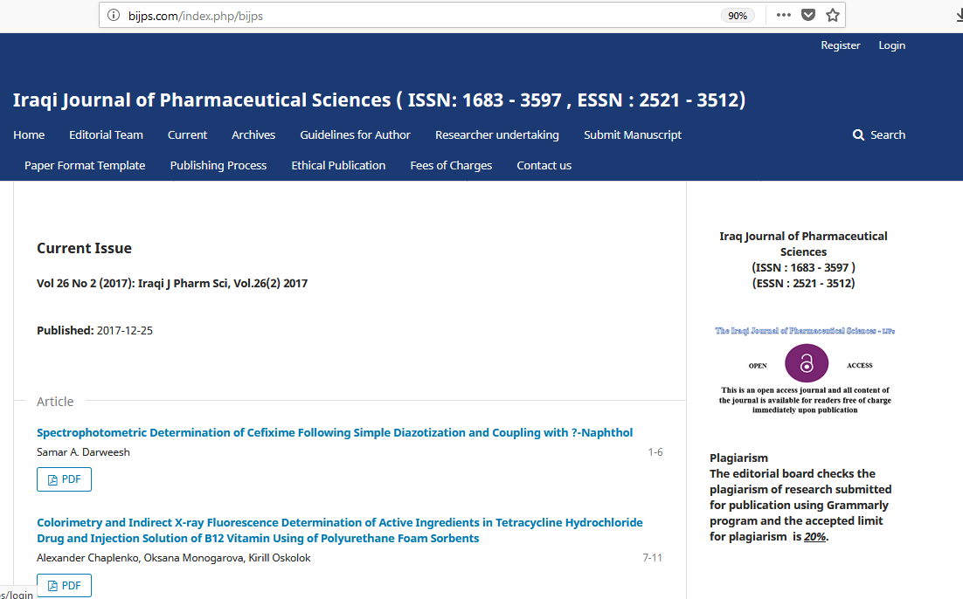
Click here

Slide 5
Input your username
Input your password

Slide 6
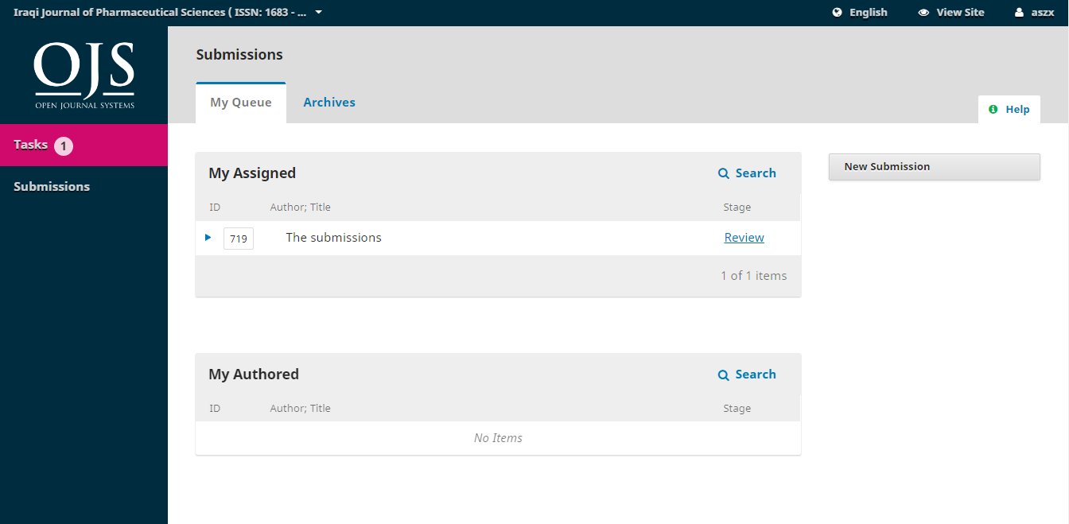
Click here

Slide 7
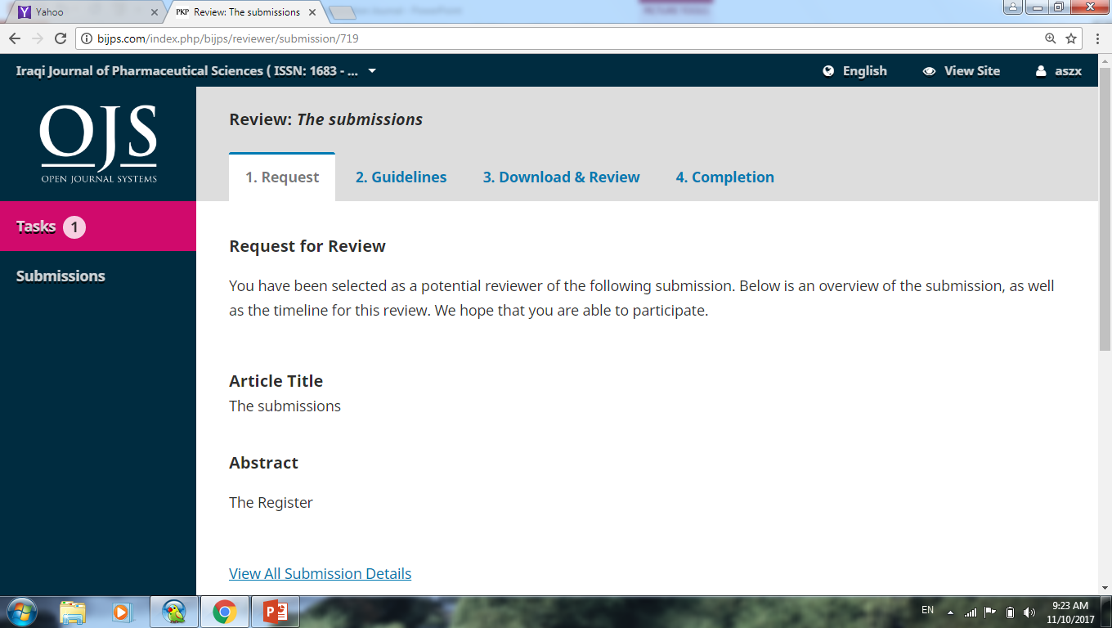

Slide 8
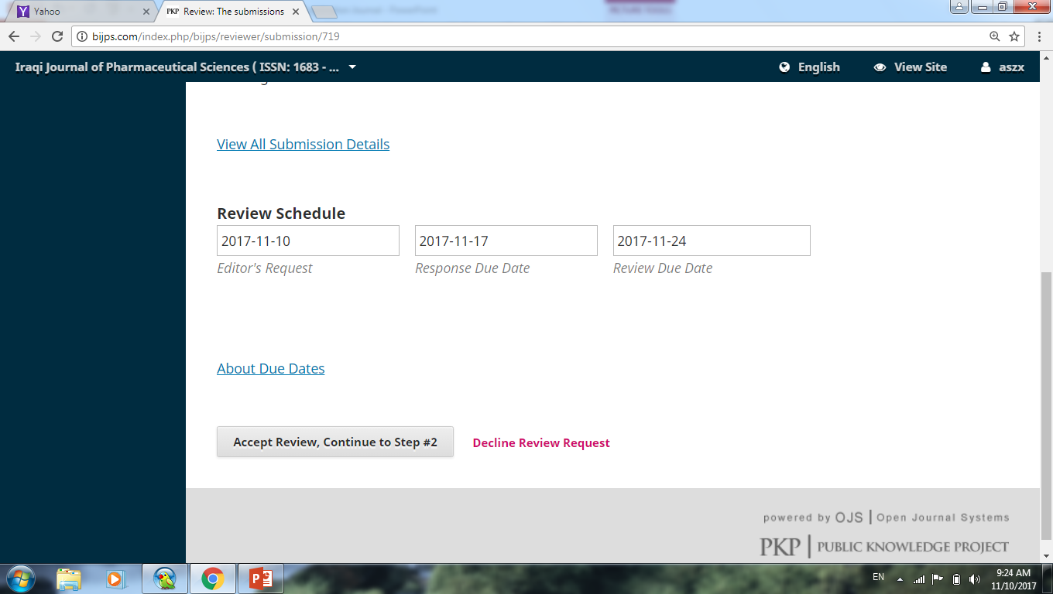
Click here if you accept to review manuscript
Click here If you decline to review manuscript

Slide 9
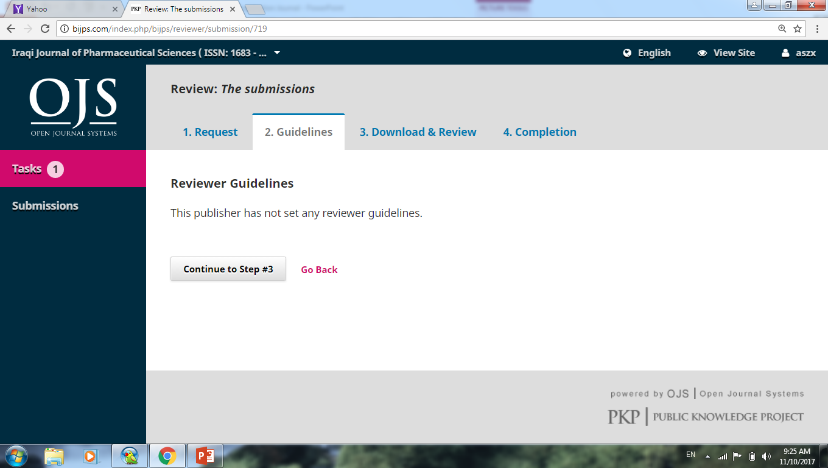
Click here

Slide 10
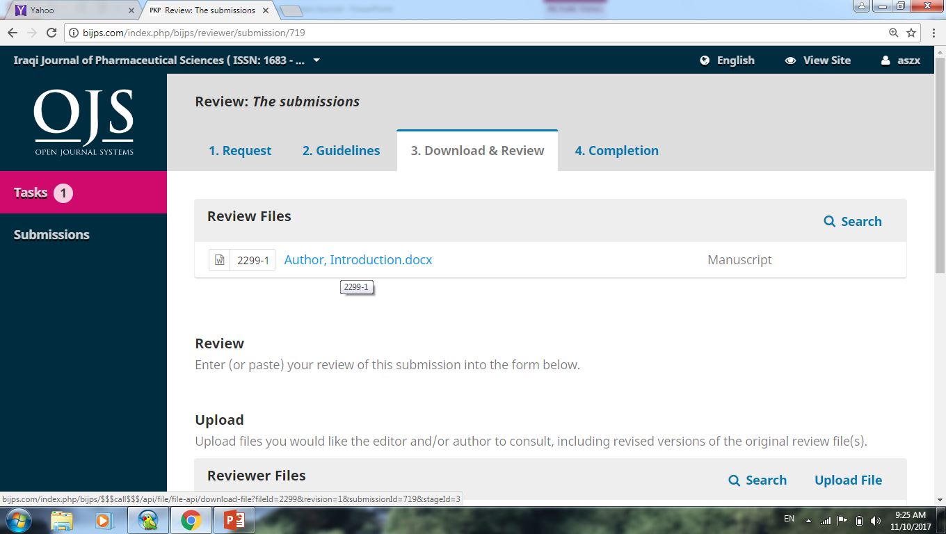
Click here

Slide 11
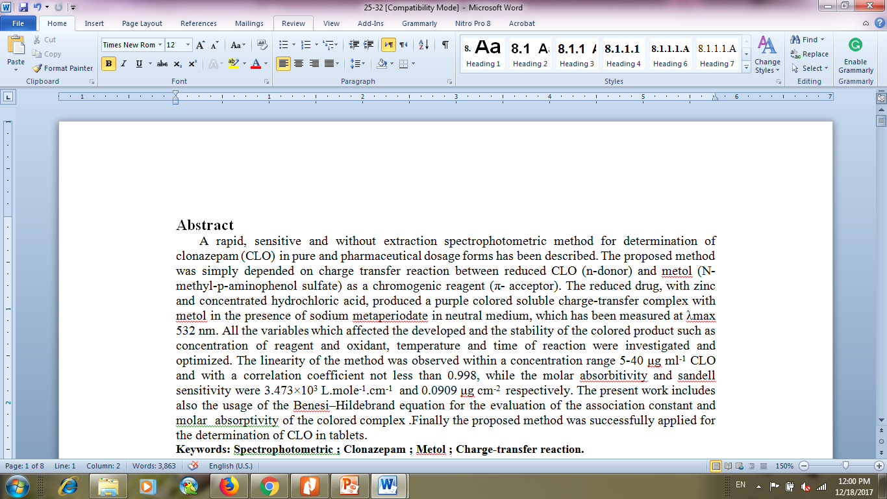
How to add your comments
Click here
Continue

Slide 12
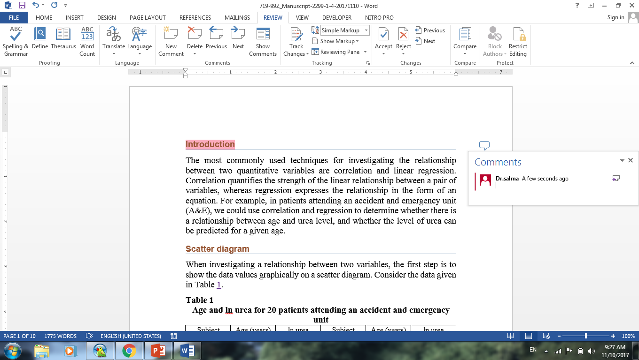
Click here
To add your comments
Click here to add your comment
Click here to remove your comment

Slide 13
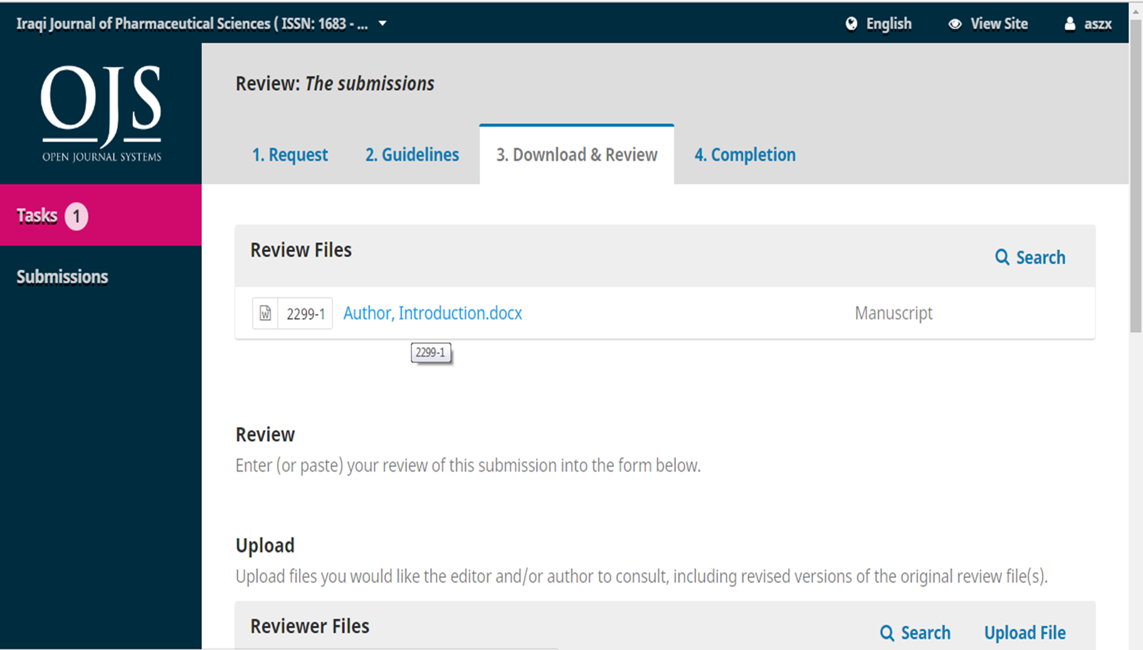
Upload your file

Slide 15
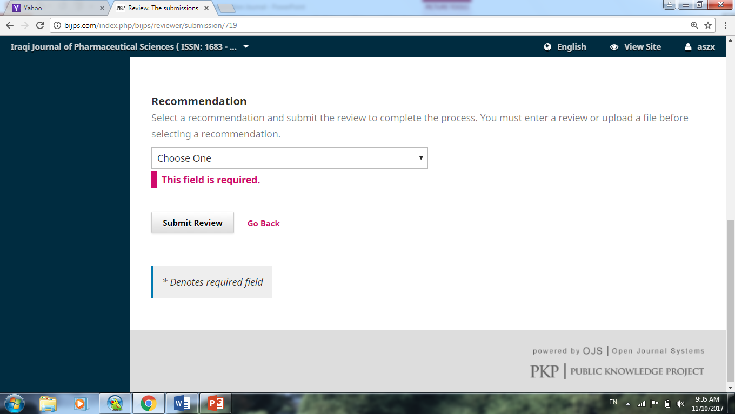
Click here

Slide 16
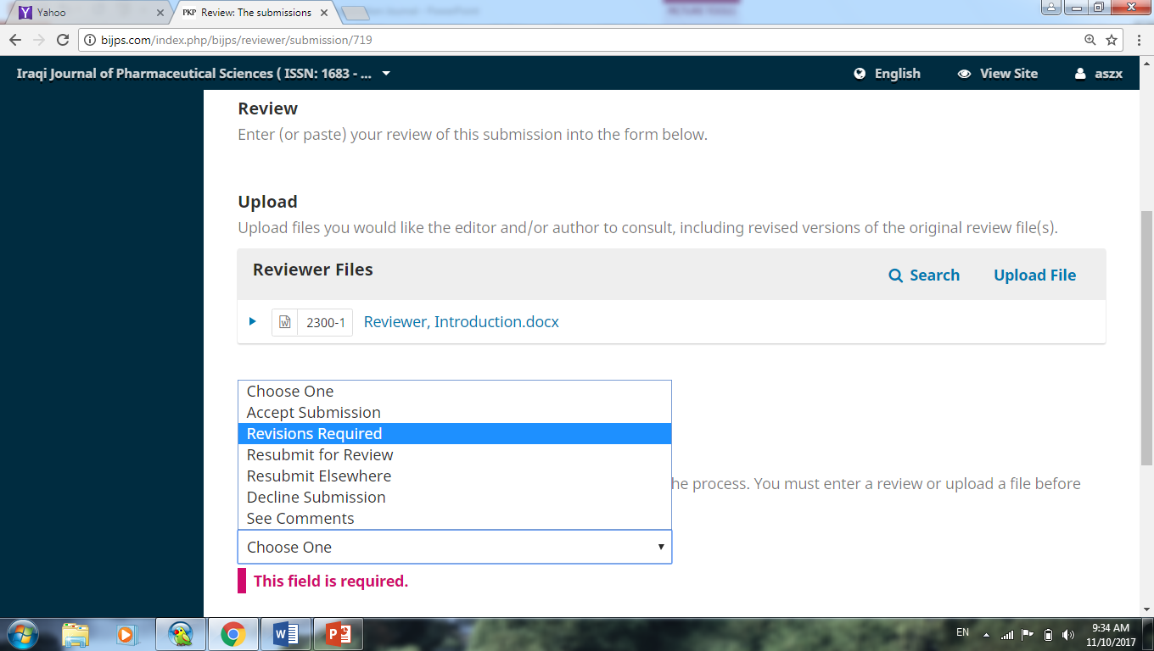
Click here

Slide 18
